Slide 1


Leveraging NVIDIA Omniverse for Robotics Simulation

Slide 2
Overview of NVIDIA Omniverse
It is a real-time simulation platform designed for collaborative 3D content creation and simulation. It allows industries to create realistic 3D worlds and simulate complex interactions using advanced graphics, physics, and AI.
Primarily used in industries like automotive, architecture, design, and robotics, Omniverse supports collaborative workflows, high-fidelity rendering, and real-time data exchange across multiple disciplines.
Built on Universal Scene Description (USD), enabling the seamless exchange of assets between various 3D design tools, making it ideal for creating highly detailed simulations with interoperability.

Slide 3
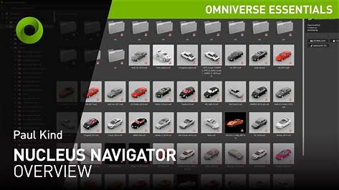
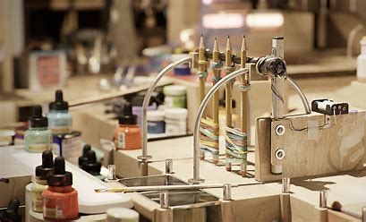
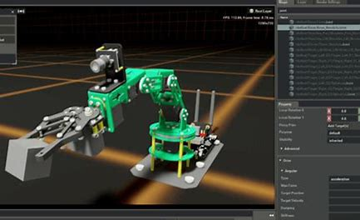
Omniverse Core Components
Omniverse Nucleus: Central server that handles collaboration, scene management, and real-time synchronization of assets.
Omniverse Create: Tool for building and editing high-fidelity 3D environments, robots, and assets.
Omniverse View: A visualization tool for immersive 3D environments and collaboration.
Omniverse Machinima: A toolset designed for cinematic content creation using real-time 3D assets.
Nvidia Nucleus
Nvidia Omniverse create
Nvidia Omniverse Machinima

Slide 4
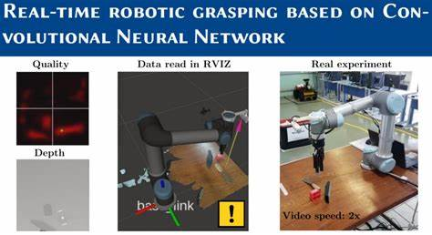
The Role of Omniverse in Robotics Simulation
End-to-End Robotics Simulation:
From design to testing and deployment, Omniverse provides a unified platform to simulate every aspect of a robot's lifecycle in a virtual environment.
Advanced Physics Simulation:
Omniverse uses NVIDIA PhysX to simulate real-world physics with high precision, allowing robots to interact with objects and environments as they would in reality. This includes accurate collision detection, friction, deformation, and material properties.
AI & Machine Learning Integration:
Omniverse facilitates the training of AI models using reinforcement learning and computer vision, making it possible to simulate and optimize robot behavior without requiring physical prototypes.
Realistic Sensor Simulations:
You can simulate LiDAR, cameras, ultrasonic sensors, and IMUs to test robots' perception systems in complex environments, enabling the training of autonomous robots for object detection, mapping, and navigation.

Slide 5
Key Features of Omniverse for Robotics
Realistic Environmental Interactions:
Simulate environments in detail: factory floors, warehouse aisles, outdoor terrains, and more. Create dynamic, changing conditions like lighting changes, weather effects, or moving obstacles.
Multi-Robot Coordination:
Omniverse allows for the testing of scenarios with multiple robots, where robots must collaborate, avoid collisions, and work together to achieve a shared goal (e.g., in automated warehouses or assembly lines).
Path Planning and Navigation:
Simulate complex navigation algorithms, such as A*, Rapidly-exploring Random Trees (RRT), and Dynamic Window Approach (DWA), for robots to navigate unknown or dynamic environments autonomously.
Grasping and Manipulation Simulations:
Simulate robotic arms and hands to test grasping, manipulation, and interaction with different objects under varying conditions (e.g., weight, texture, shape).

Slide 6
Software and Simulation Tools : Core components
Omniverse Nucleus:
The central hub where all assets (3D models, physics, AI models, etc.) are managed and stored. Nucleus handles the collaborative aspects of Omniverse, synchronizing work between multiple users in real time.
Omniverse Create:
Used for designing detailed robotic systems and environments. It allows users to build robot models, simulate sensor inputs, and test robot behaviors in different conditions.
Omniverse View:
Ideal for visualizing and interacting with simulation results, and collaborating on project progress. It allows for the immersive review of robotic performance and testing outcomes.

Slide 7
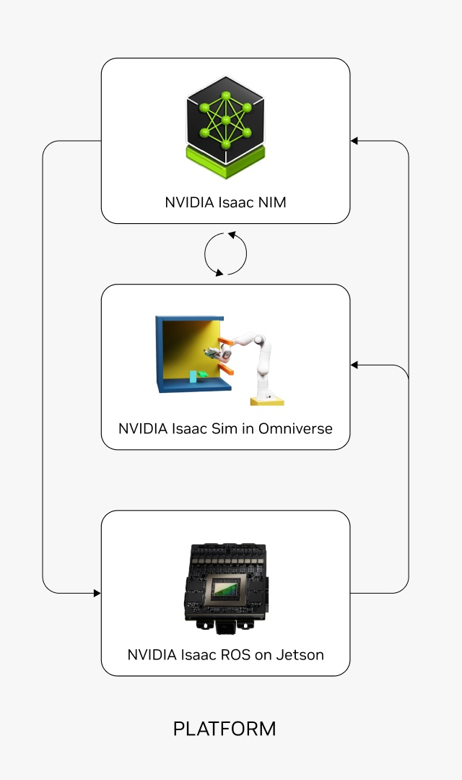
Software and Simulation Tools : Isaac SDK
Isaac Sim:
Provides a robotics simulation environment built on Omniverse. It allows for creating and testing robotics applications, such as manipulation, grasping, navigation, and autonomous driving, in realistic settings.
Isaac Gym:
A high-performance reinforcement learning environment where robots can be trained in physics-based simulations using large-scale AI algorithms.
Isaac Sight:
Tools for computer vision integration. This allows robots to "see" and process visual inputs from sensors and cameras in their simulated environments, aiding object recognition, obstacle avoidance, and SLAM (Simultaneous Localization and Mapping).

Slide 8
Software and Simulation Tools : ROS (Robot Operating System) Integration
Omniverse's integration with ROS allows for seamless interaction between simulated robots and real-world robots. You can develop ROS-based control systems in Omniverse and test them in a virtual environment before deploying them on physical robots.
ROS 2 offers better support for real-time communication, multi-robot coordination, and distributed systems, making it ideal for industrial applications.

Slide 9
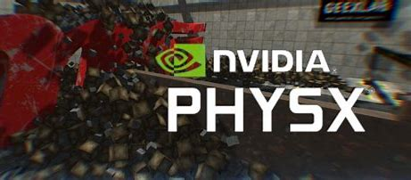
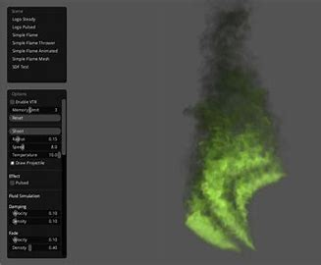
Software and Simulation Tools : Physics Engines
NVIDIA PhysX:
Enables high-accuracy physics simulation for robot movements, interactions with objects, collision detection, and environmental interactions.
NVIDIA Flow:
A fluid simulation tool to model gases and liquids, useful for simulating environments with smoke, fire, or water (e.g., drones flying through smoke, or robots working with liquid materials).
Nvidia Flow

Slide 10
Robotics Simulation Workflow in Omniverse
Design & Modeling in Omniverse Create:
Start by designing the robot in 3D using Omniverse Create or import CAD models from external design tools (like SolidWorks or Fusion 360).
Assemble and configure robotic components such as sensors, actuators, robotic arms, grippers, and wheels.
Setting up the Environment:
Use Omniverse Create to design realistic environments where the robot will operate. This includes specifying indoor/outdoor settings, terrain, obstacles, dynamic objects, and lighting.
Import 3D assets or choose pre-made environments from the Omniverse Asset Library.
Integrating Sensors and Actuators:
Simulate the robot’s sensors (LiDAR, cameras, force sensors, etc.) in the environment.
Test robot perception using Omniverse AI capabilities like computer vision (via Isaac Sight) for object detection and navigation.

Slide 11
Robotics Simulation Workflow in Omniverse
AI & Reinforcement Learning:
Integrate AI models for decision-making, path planning, and learning. Use Isaac Gym for training robots through reinforcement learning.
Train robots to perform specific tasks like grasping, manipulation, or navigating through dynamic environments.
Run Simulation and Test:
Perform simulations in real-time and monitor robot behaviors using the built-in physics engine.
Test performance in various conditions (e.g., adverse lighting, rainy conditions, obstacle-laden environments).
Iterative Testing & Optimization:
Based on simulation results, tweak robot designs, sensor configurations, and AI models.
Use Omniverse View to collaborate with remote teams and share insights or make adjustments.

Slide 12
Integration with Robotics Software Tools
ROS (Robot Operating System):
Omniverse provides full compatibility with ROS, enabling easy integration between the simulated environment and real-world robots.
ROS-Omniverse Bridge: This allows communication between the ROS framework (used for robot control) and Omniverse for simulation, making it easy to test code on a virtual robot before deploying to physical robots.
Gazebo and Other Simulation Tools:
While Gazebo is a widely-used open-source simulator for robotics, Omniverse offers a more powerful, scalable, and visually immersive alternative with real-time physics, AI integration, and collaborative features.
TensorFlow/PyTorch for AI Integration:
Use TensorFlow or PyTorch with Omniverse to implement and train AI models directly within the simulation environment. This makes training faster and safer before deploying on actual robots.

Slide 13
Omniverse-ROS Workflow
Design and Simulate: Use Omniverse to design robots and simulate behaviors in a highly detailed 3D environment.
Develop Control Algorithms: Write and test ROS control software (e.g., motion planning, SLAM) in Omniverse.
Test and Validate: Validate the robot’s physical behavior in a virtual environment with high-fidelity physics and sensor feedback.
Deploy to Real Hardware: After simulations and testing, deploy ROS-based software to actual robots, ensuring compatibility and reducing the risk of errors in the real world.

Slide 14
NVIDIA Isaac Sim
NVIDIA Isaac Sim™ is a reference application built on NVIDIA Omniverse that enables developers to simulate and test AI-driven robotics solutions in physically based virtual environments.
Isaac Sim, built on NVIDIA Omniverse™, is fully extensible. This means you can build your own Universal Scene Description (OpenUSD)-based custom simulators or integrate core Isaac Sim technologies into your existing testing and validation pipelines.

Slide 15
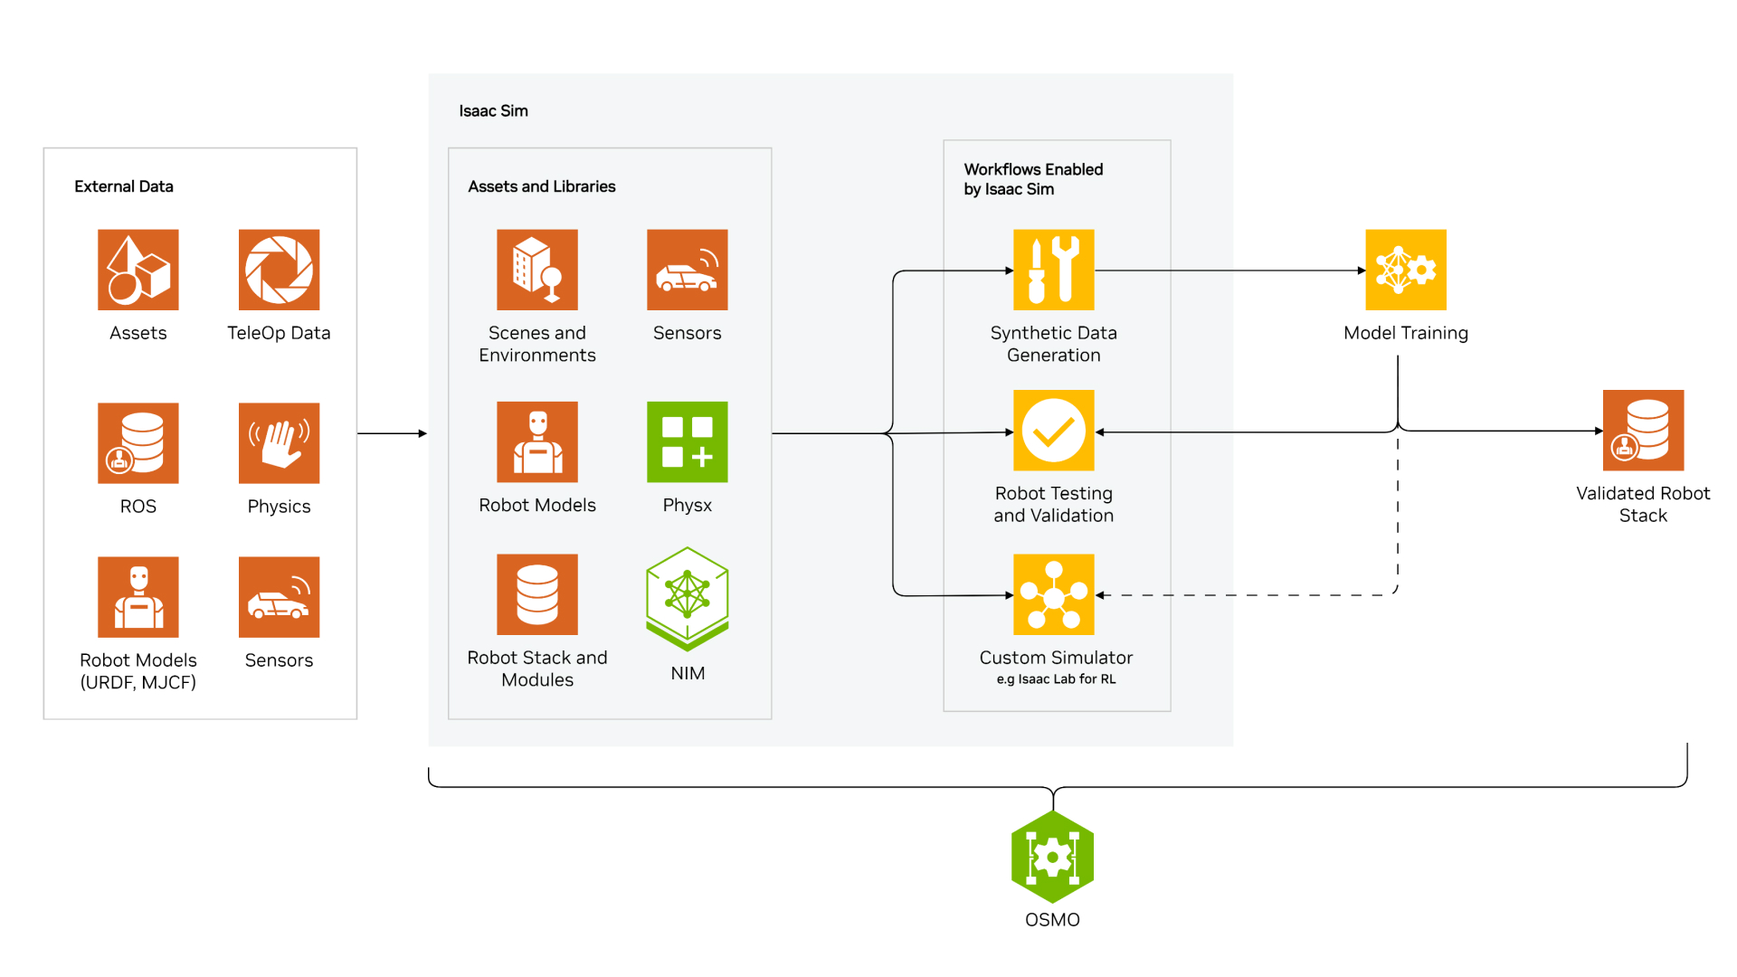
How Isaac Sim Works
Isaac Sim facilitates three essential workflows: generating synthetic data for training perception models, conducting software-in-loop testing for complete robot stacks, and enabling robot learning through Isaac Lab.

Slide 16
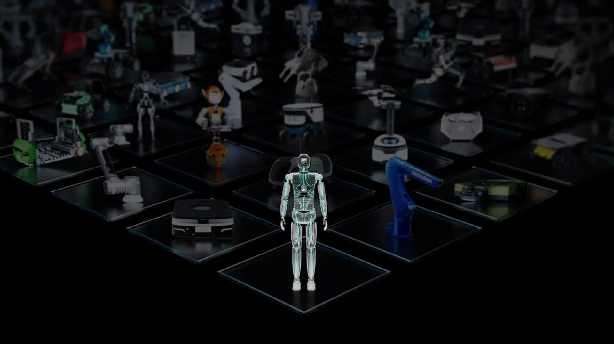
Key Features
Pre-Populated Robots and SimReady Assets
Isaac Sim has a host of third-party robot models built on OpenUSD that have the ideal physics properties to speed up robot simulation.
Humanoids: 1X, Agility, Fourier Intelligence, and Sanctuary
Manipulators: Fanuc, KUKA, Universal Robots, and Techman
Quadrupeds: ANYbotics, Boston Dynamics, and Unitree
AMRs: idealworks, iRobot
Access over 1,000 SimReady 3D assets—including conveyors, boxes, and pallets—to build your simulation scene.

Slide 17
Key Features
Bootstrapped AI Model Development
Bootstrap AI model training with synthetic data generation, where data is limited or restricted.
Scalable Testing and Validation
Test a single robot or an entire fleet, operating in complex and dynamic environments under various conditions and configurations.
Modular Architecture for Robotics Workflows
Develop custom workflows to accommodate various types of robots, such as humanoids, manipulators, and autonomous mobile robots (AMRs).
Realistic Physics Simulation
Tap into NVIDIA® PhysX® for physics capabilities like mimic joints, as well as rigid and soft-body collisions.

Slide 18
Key Features
Bootstrapped AI Model Development
Bootstrap AI model training with synthetic data generation, where data is limited or restricted.
Scalable Testing and Validation
Test a single robot or an entire fleet, operating in complex and dynamic environments under various conditions and configurations.
Modular Architecture for Robotics Workflows
Develop custom workflows to accommodate various types of robots, such as humanoids, manipulators, and autonomous mobile robots (AMRs).
Realistic Physics Simulation
Tap into NVIDIA® PhysX® for physics capabilities like mimic joints, as well as rigid and soft-body collisions.

Slide 19
Example Workflow: Using Omniverse for Robotics Simulation in a Warehouse
Step 1: Design the Robot (Omniverse Create)
Start by creating a 3D model of the autonomous mobile robot (AMR), including wheels, grippers, sensors, and cameras.
Import CAD files from external design tools (e.g., SolidWorks) and fine-tune the design for performance in the warehouse environment.
Step 2: Create the Warehouse Environment
Use Omniverse Create to design a virtual warehouse with aisles, shelves, and bins for testing the robot’s ability to navigate and handle objects.
Simulate lighting conditions (e.g., bright, dim, or colored lights) and environmental factors (e.g., humidity or dust) that the robot may encounter in real-world operations.

Slide 20
Example Workflow: Using Omniverse for Robotics Simulation in a Warehouse
Step 3: Simulate Robot Navigation and Task Performance
Use Isaac Sim and NVIDIA PhysX for simulating the robot’s autonomous navigation across the warehouse, detecting obstacles, and optimizing its path.
Integrate AI models trained using reinforcement learning in Isaac Gym for navigation and task execution.
Step 4: Sensor and Perception Testing
Simulate LiDAR and cameras in Omniverse to test how the robot perceives and reacts to obstacles, bins, and people in the warehouse.
Use Isaac Sight to validate sensor accuracy and improve decision-making algorithms for grasping and object handling.

Slide 21
Example Workflow: Using Omniverse for Robotics Simulation in a Warehouse
Step 5: Multi-Robot Coordination
If testing multiple robots in the warehouse, simulate and coordinate actions between AMRs to optimize warehouse logistics, such as moving goods from one area to another, without collisions.
Use AI reinforcement learning for robots to learn how to collaborate and avoid blocking paths.
Step 6: Analyze Results & Optimize
Review robot performance with stakeholders in Omniverse View, and use simulation data (e.g., task completion times, collision rates) to optimize robot design and AI algorithms.

